Slide 1
Checking understanding of algebraic notation
Solving linear equations

Slide 2
how to use Oak lessons

Slide 3
I can represent situations using algebra.

Slide 4
An expression contains one or more terms, where each term is separated by an operator.
An equation is used to show 2 expressions that are equal to each other.
An integer is any positive or negative whole number or zero. E.g. −2, 0, 153 are all examples of integers.

Slide 5

Checking understanding of algebraic notation
Missing number problems
Expressing problems algebraically

Slide 6
Missing number problems
Missing number problems occur often in mathematics and real life situations.
Here is a problem:
Alex has 5 blocks of different heights.
How could we start to solve this problem?
He lines them up from smallest to largest.
Each block is 2 cm taller than the previous block.
If he stacks the two smallest blocks on top of each other, they are the same height as the largest block.
How tall would a tower of all 5 blocks be?

Slide 7
Missing number problems
We could start by picking out key information.
Each block is 2 cm taller than the previous block.
The sum of the two smallest is equal to the largest.
We could draw a diagram to help:
2
2
Remember the diagram is only a guide.
2
2

Slide 8
Missing number problems
2
2
Each block is 2 cm taller than the previous block.
The sum of the two smallest is equal to the largest.
2
2
You may wish to try some heights for the blocks to see roughly how big your answer should be.
If the smallest was 3 cm: 3, 5, 7, 9, 11
3 + 5 = 8
The smallest block must be bigger than 3

Slide 9
Missing number problems
2
2
2
2
2
Each block is 2 cm taller than the previous block.
The sum of the two smallest is equal to the largest.
2
2
2
2
2
2
2
2
2
?
?
?
?
?
What is the key piece of information we don’t know which would help us solve this?
2
2
?
2
2
The height of one of the blocks - e.g. the smallest block.
2
?
?
It can be helpful to look at how all the other heights are related to the smaller block.
Can you now work out the height of the smallest block?

Slide 10
Missing number problems
2
2
Each block is 2 cm taller than the previous block.
The sum of the two smallest is equal to the largest.
How tall would a tower of all 5 blocks be?
2
2
2
2
2
2
2
2
2
2
2
2
?
?
?
?
?
Can you now work out the height of the smallest block?
2
2
?
2
The smallest block is 6 cm.
2
2
?
?
How tall would a tower of all 5 blocks be?
50 cm

Slide 11
Missing number problems
In the previous problem there were some elements of the problem that helped us solve it:
We were told how each of the heights were related to each other.
We were given a statement of equality – two smaller blocks were equal in height to the largest block.
Methods that helped us investigate this problem:
drawing a diagram
trying a number
picking an unknown value (?) and writing the other values in relation to it

Slide 12
Missing number problems
Let’s see if we can apply any of those methods to investigate another missing number problem.
Izzy has two sticks.
When she balances them on top of each other their total height is 70 cm.
When she stands them next to each other, one is 8 cm taller than the other.
How long is each stick?
How could we start to solve this problem?

Slide 13
Missing number problems
The total height of the 2 sticks is 70 cm.
One is 8 cm taller than the other.
Drawing a diagram:
Trying a value:
If the smaller one was 20 cm, the larger one would be 28 cm.
70
8
20 + 28 = 48
The smaller stick is longer than 20 cm.
Have a go at solving this problem now.

Slide 14
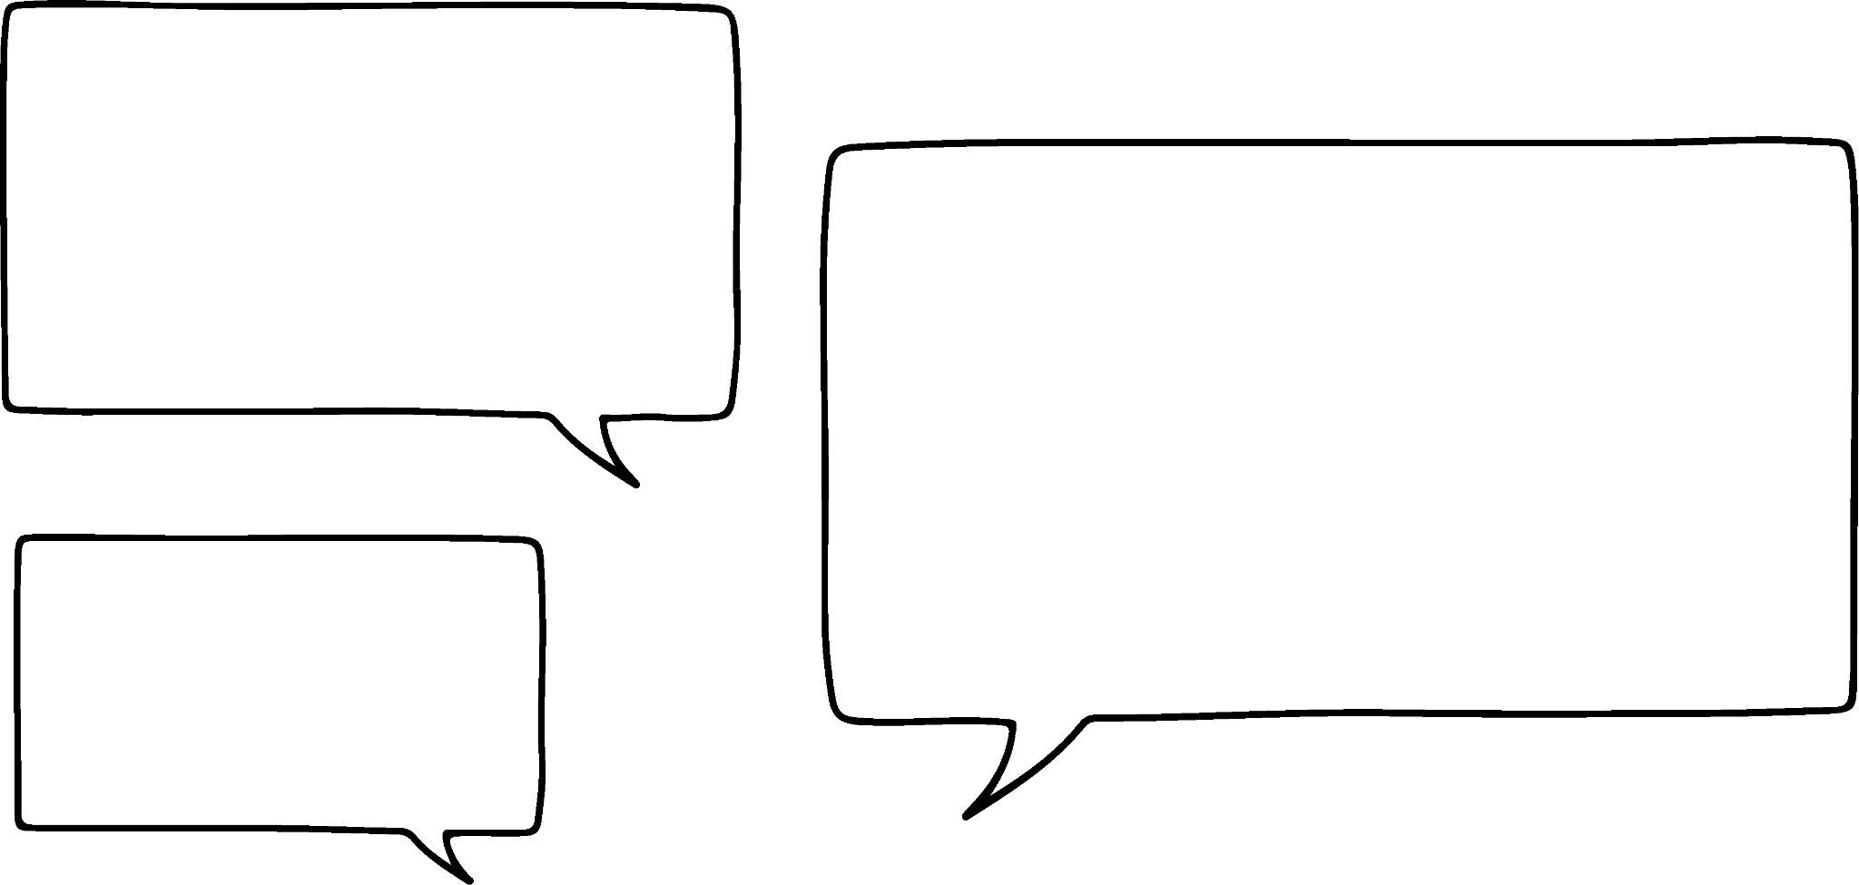
Missing number problems
The total height of the 2 sticks is 70 cm
One is 8 cm taller than the other.
Andeep and Sofia have a go at solving this problem too.
Have a look at their working. Did you approach this in a similar way? What should they do next?
Andeep:
Sofia:
The small bit of green is worth 8, so the two purple sections are worth 62
G | = | P + 8
G + P | = | 70
P + 8 + P | = | 70
P + P | = | 62
8
70

Slide 15
Missing number problems
Andeep:
Sofia:
The small bit of green is worth 8, so the two purple sections are worth 62
G | = | P + 8
G + P | = | 70
P + 8 + P | = | 70
P + P | = | 62
8
70
This is the same method just with letters instead of diagrams.
Halve 62 to get the length of the purple (smaller) rod.
Sofia has written an equation.
purple = 31 cm
P = 31 cm
G = 39 cm
green = 39 cm

Slide 16
Missing number problems
We can use letters to represent an unknown value.
When we are given a statement of equality, we can write an equation to show the relationship between values.
We can write an equation when we have more than one unknown as well.

Slide 17
Missing number problems
Laura has collected 120 coins in a video game.
It costs 30 coins to buy a pet and 10 coins to play a mini game.
How could she spend all her coins so none are wasted?
How could we write this problem as an equation?
30p + 10g = 120
(where p is the number of pets and g is the number of games)
Can you find values for p and g which work?

Slide 18
Missing number problems
30p + 10g = 120
(where p is the number of pets and g is the number of games)
Can you find values for p and g which work?
Number of pets bought (p) | Number of mini games possible (g)
1 | 9
2 | 6
3 | 3
4 | 0
Why do p and g have to be positive integers?
They represent the ‘number of times’ something is happening.

Slide 19


Missing number problems
Izzy has two sticks. One is exactly double the length of the other.
When she stands them on top of each other they are 24 cm high.
What is the length of each stick?
Which diagram best represents this problem?
?
?
?
?
24
24
2
?
24
24
?
?
?
?
?
a
b
c
d

Slide 20
Missing number problems
Izzy has two sticks. One is exactly double the length of the other.
When she stands them on top of each other they are 24 cm high.
What is the length of each stick?
Use the diagram to solve the problem.
?
24 ÷ 3 = 8
?
24
The smaller stick is 8 cm, the larger stick is 16 cm.
?

Slide 21
Missing number problems
1) Solve the following problems. You may wish to use a diagram to help you.
a)
A recipe for fruit cake requires the same amount of currants and sultanas but twice as many raisins.
Altogether you need 420 g of dried fruit.
How much of each fruit do you need?
b)
Jacob was 6 years old when his puppy was born.
At what age would he be exactly double his puppy’s age?
At what age would he be exactly three times his puppy’s age?

Slide 22
Missing number problems
1) Solve the following problems. You may wish to use a diagram to help you.
c)
A rectangle is drawn where its length is double its width.
If its perimeter is 24 cm, what is the area of the rectangle?
d)
The length of a rectangular cupboard is 1 m longer than its width.
The perimeter of the cupboard floor is 9 m; what is its area?
Leave your answer as a fraction.

Slide 23

Missing number problems
2) Solve the following problems. You may wish to use a diagram to help you.
a)
Sour sweets cost 30 p and toffees cost 25 p.
Laura has £1.70 and wants to spend all her money with no change left over.
How many of each can she buy?
b) Sam has written the equation 2a + 3b = 26
There are two answers to this problem.
a = 4 and b = 6 or
a = 1 and b = 8
Sam
Explain why Sam is incorrect.

Slide 24
Missing number problems
1) Solve the following problems. You may wish to use a diagram to help you.
a)
A recipe for fruit cake requires the same amount of currants and sultanas but twice as many raisins.
Altogether you need 420 g of dried fruit.
How much of each fruit do you need?
420 g
?
?
?
?
currants
sultanas
raisins
420 ÷ 4 = 105 g
c = 105 g
s = 105 g
r = 210 g

Slide 25
Missing number problems
1) Solve the following problems. You may wish to use a diagram to help you.
b)
Jacob was 6 years old when his puppy was born.
At what age would he be exactly double his puppy’s age?
At what age would he be exactly three times his puppy’s age?
?
6
Jacob would be double the puppy’s age when he is 12.
?
?
?
6
Jacob would be three times the puppy’s age when he is 9.
6
?
?
?
?
?
puppy
Jacob

Slide 26

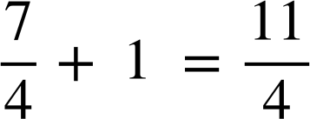
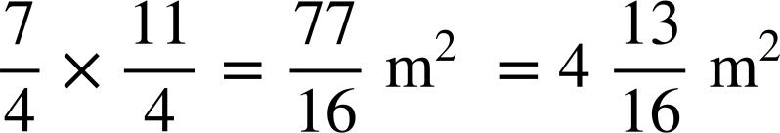
Missing number problems
1) Solve the following problems. You may wish to use a diagram to help you.
c)
A rectangle is drawn where its length is double its width.
If its perimeter is 24 cm, what is the area of the rectangle?
d) The length of a rectangular cupboard is 1 m longer than its width.
The perimeter of the cupboard floor is 9 m; what is its area?
Leave your answer as a fraction.
?
?
7 ÷ 4 =
?
1
24 ÷ 6 = 4 cm
?
?
?
?
4 × 8 = 32 cm²
?
?
?
1

Slide 27
Missing number problems
2) Solve the following problems. You may wish to use a diagram to help you.
a)
Sour sweets cost 30 p and toffees cost 25 p.
Laura has £1.70 and wants to spend all her money with no change left over.
How many of each can she buy?
b) Sam has written the equation 2a + 3b = 26
There are two answers to this problem.
a = 4 and b = 6 or
a = 1 and b = 8
Sam
Explain why Sam is incorrect.
Without context, a and b could be negative numbers or decimals so there are an infinite number of answers.
4 sour sweets and 2 toffees

Slide 28
Checking understanding of algebraic notation
Missing number problems
Expressing problems algebraically

Slide 29
Expressing problems algebraically
We can form expressions for real life situations using letters to represent unknowns or variables.
This year, Aisha’s dad is exactly 4 times her age. How could we write an expression for his age?
We could use the letter a to represent Aisha’s unknown age.
Her dad’s age would be a × 4
4a
Aisha’s aunt is 3 years younger than Aisha’s dad. How could we write an expression for her age?
4a − 3

Slide 30


Expressing problems algebraically
Aisha’s cousin is twice her age plus 4. How could we write an expression for their age?
2a + 4
If I add 4 to my age then double it, I get my sister’s age.
That means your sister and cousin are the same age.
Jacob
Aisha
Is Jacob correct?

Slide 31
Expressing problems algebraically
How could we write an expression for Aisha’s sister’s age?
Adding 4 to Aisha’s age would give a + 4
If her sister is double that, we can write her age as 2(a + 4)
Brackets are needed because it is the whole expression for Aisha’s age plus 4 that needs to be doubled.
Aisha’s cousin: 2a + 4
Are these the same?
Aisha’s sister: 2(a + 4)
No, the brackets change the priority of operations. For Aisha’s cousin, only the a is doubled.
2(a + 4) ≡ 2a + 8

Slide 32
Expressing problems algebraically
Match up the statements with an expression which represents it.
A number add 3, then multiplied by 4
4b + 3
4 plus a number, then times 3
4(b + 3)
4 lots of a number add 3
4 + b × 3
3(b + 4)
A number multiplied by 3, then added to 4

Slide 33








Expressing problems algebraically
Match up the statements with an expression which represents it.
(or )
A third of a number
4 lots of a number divided by 3
(or )
A quarter of a number
(or )
A number divided by 4 then multiplied by 3
(or )

Slide 34
Expressing problems algebraically
In a bar model, if a bar representing one expression is the same length as another bar then the expressions are equal.
When two expressions are equal, we can form an equation.
12
x
x
x
x
x
x
5
For this bar model we could write the equation: 12 + 2x = 4x + 5

Slide 35


Expressing problems algebraically
We can write an equation for any scenario where we know things are equal.
b
+ 10
I’m thinking of a number. When I add 10 then divide by 5, I get the number 6.
= 6
Jacob
But when I divide by 5 then add 10, I get the number 14. How will this look different?
+ 10
= 14
In fractional notation, the numerator and denominator are grouped so brackets are not needed here.

Slide 36
Expressing problems algebraically
Lucas and Andeep each have some sweets. When Lucas gives 5 of his to Andeep, they both have the same amount.
How could we form an equation for this scenario?
b = number of sweets Lucas has.
a = number of sweets Andeep has.
After Lucas gives Andeep 5, how many do they each have?
b − 5 = a + 5
How many sweets could they have started with?

Slide 37
Expressing problems algebraically
How many sweets could they have started with?
Any number where Lucas has 10 more than Andeep.
E.g. If Lucas had 20 and Andeep had 10, when Lucas gives Andeep 5, they both have 15.
Where an equation has more than one unknown number, it is possible for there to be more than one option for values that make it true.

Slide 38
Expressing problems algebraically
Pick a number from the box for c and a different number from the box for d to make this equation true c + 3d = 16
5
4
10
7
1
13
c = 1 and d = 5
0
16
6
c = 13 and d = 1
c = 16 and d = 0
How many answers can you find?

Slide 39
Expressing problems algebraically
If a and b are integers, there are 5 possible answers for the value of a and b in the equation 4a + 2b = 20
a can be 0, 1, 2, 3, 4, or 5 so there are 6 possible answers.
Integers include negative numbers so there are an infinite number of answers.

Slide 40
Expressing problems algebraically
Match the bar models to the equations.
a)
b)
c)
d)
e)
a + 5 = a + 4x
a
x
x
x
x
5
5
2a + 5 = 4x + 3
x
x
x
x
a
a
a
5
5 = 4x + a
x
x
x
x
3
a
5
4x + 5 = a
x
x
x
x
a
5
x
a
a + 2x + 3 = a + x + 5
x
x
3
a

Slide 41
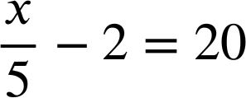
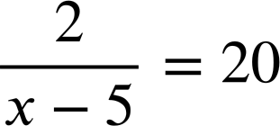
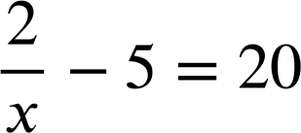
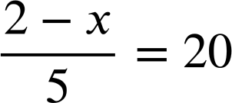
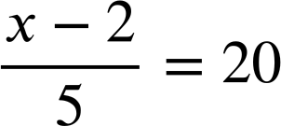
Expressing problems algebraically
2) Match the statements to the equations.
A number minus 2 then divided by 5 equals 20
a)
b)
c)
d)
e)
A number divided by 5 then minus 2 equals 20
2 divided by 5 less than a number equals 20
2 divided by a number then minus 5 equals 20
A number subtracted from 2 then divided by 5 equals 20

Slide 42
Expressing problems algebraically
Match the bar models to the equations.
a)
b)
c)
d)
e)
a + 5 = a + 4x
a
x
x
x
x
5
5
2a + 5 = 4x + 3
x
x
x
x
a
a
a
5
5 = 4x + a
x
x
x
x
3
a
5
4x + 5 = a
x
x
x
x
a
5
x
a
a + 2x + 3 = a + x + 5
x
x
3
a

Slide 43
Expressing problems algebraically
2) Match the statements to the equations.
A number minus 2 then divided by 5 equals 20
a)
b)
c)
d)
e)
A number divided by 5 then minus 2 equals 20
2 divided by 5 less than a number equals 20
2 divided by a number then minus 5 equals 20
A number subtracted from 2 then divided by 5 equals 20

Slide 44
Checking understanding of algebraic notation
With enough information, we can find missing numbers in context.
We can solve missing number problems by using diagrams or equations.
Missing number problems and real life situations can be expressed using algebra.
If a problem or equation has two unknowns, possible pairs of numbers can be found that make the statement true.

Slide 45

© Oak National Academy 2023.
Produced in partnership with Mathematics in Education and Industry.
Licensed on the Open Government Licence v3.0, except where otherwise stated. See Oak terms and conditions.

